Slide 1

An Autonomous Institution
SOFT SKILLS
25HU101/201
Unit 2
Department of Applied Science and Humanities

Slide 2
UNIT-02
Listening Process, Types, Barriers, Traits of a Good Listener, and TED Talk Listening

Slide 3
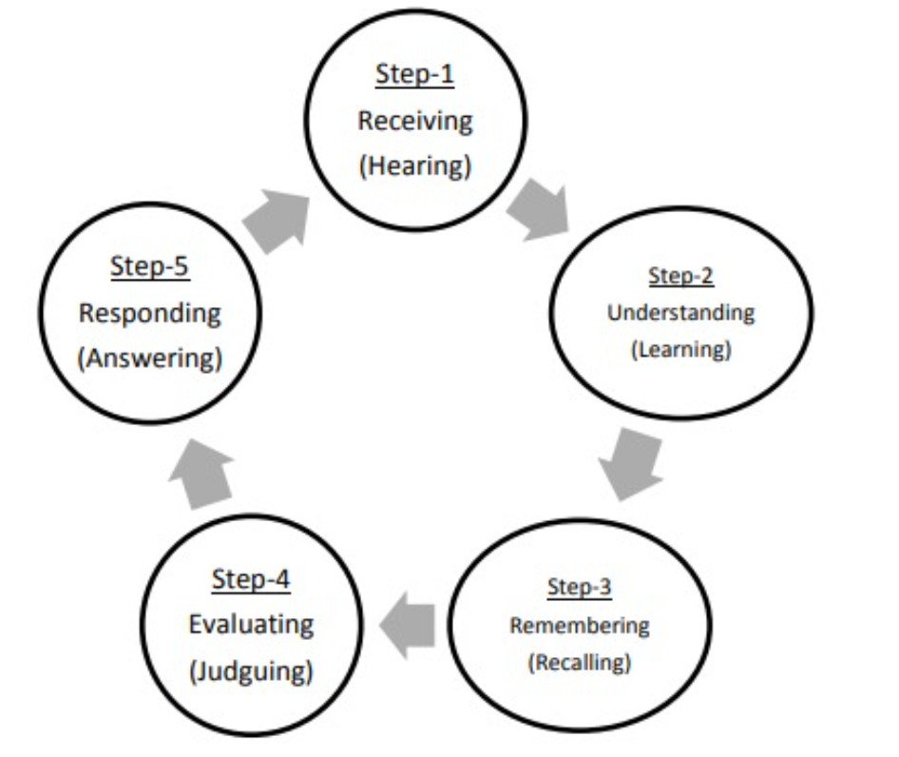
Listening Process
The listening process is the step-by-step method by which we receive, understand, and respond to spoken messages. It usually includes hearing, understanding, remembering, evaluating, and responding.
https://tenrycolle.com/skills/lisening/definition-and-stages-of-listening-process/

Slide 4
2.Modes of Listening:
1. Active Listening Mode: Fully concentrating and responding to the speaker.
2 Passive Listening Mode: Listening but not involved or not asking or not clarifying.

Slide 5
Types of Listening
Listening can take many forms depending on purpose and context like:
1.Informational Listening: Listening to learn and understand new information.
2.Discriminative listening: Instead of relying on words, discriminative listening focuses on tone of voice, verbal cues, body language, and other nuances.
3.Empathetic Listening: Understanding and sharing the speaker’s feelings.
4.Critical Listening: Evaluating the message for logic and credibility for problem solving.
5.Selective Listening: Focusing on specific parts of the message while ignoring others.
6.Appreciative Listening: Enjoying the sounds, such as music or storytelling.
7.Reflective Listening: actively demonstrate that you hear, understand, and process the speaker’s message. Then you communicate the information back to them to confirm it was understood correctly.

Slide 6
Listening Barriers
Barriers are factors that hinder effective listening and understanding. Here are six common types:
1. Physical Barriers: External noise or environmental distractions (e.g., loud construction sounds).
2. Psychological Barriers: Mental distractions like stress, anger, or prejudices affecting focus.
3. Semantic Barriers: Misunderstandings caused by unclear language or jargon.
4. Physiological Barriers: Physical conditions such as hearing impairment or fatigue.
5. Language Barriers: Difficulty understanding due to unfamiliar accents or language differences.
6. Selective Listening: Hearing only what interests you and ignoring the rest.

Slide 7
Traits of a Good Listener
Good listeners have qualities that help them understand and connect effectively. Six important traits are:
1. Attentiveness: Fully focusing on the speaker without distractions.
2. Patience: Allowing the speaker to finish without interrupting.
3. Open-mindedness: Being willing to hear and consider different viewpoints.
4. Empathy: Understanding and relating to the speaker’s emotions.
5. Non-judgmental Attitude: Avoiding quick conclusions or biases while listening.
6. Providing Feedback: Giving appropriate verbal or non-verbal responses to show understanding.

Slide 8
TED Talk Listening
A TED Talk is a short, powerful presentation where speakers share ideas, stories, or research on a variety of topics. Listening to TED Talks helps improve comprehension, critical thinking, and note-taking skills by exposing listeners to clear, engaging, and well-structured speeches.
    1. Julian Treasure – “5 Ways to Listen Better” and summarise its message.
    2.Amy Cuddy: Your Body Language May Shape Who You Are
    https://www.youtube.com/watch?v=Ks-_Mh1QhMc
    3.Mark Bowden: 10 Ways to Have a Better Conversation
    https://www.youtube.com/watch?v=H6n3iNh4XLI
    4.Janine Driver: The Power of Body Language
    https://www.youtube.com/watch?v=Iy1krt06-Gs
    5.Celeste Headlee: 10 Ways to Have a Better Conversation
    https://www.youtube.com/watch?v=H6n3iNh4XLI

Slide 9
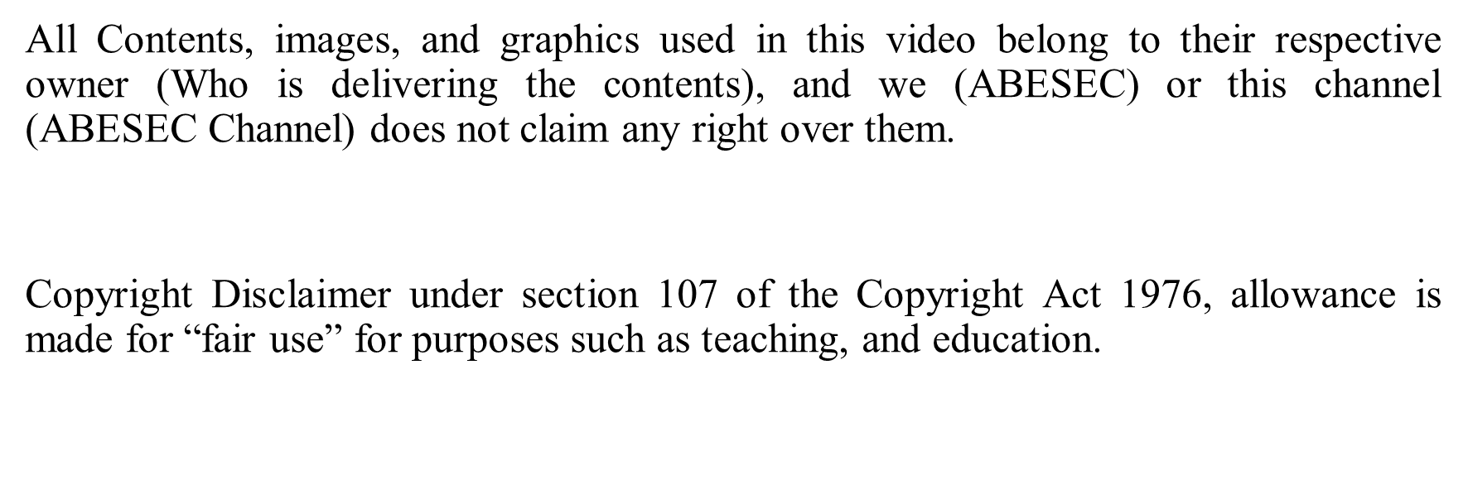
Disclaimer

Slide 10
Thank You

